Slide 1

UESTC 信息与通信工程学院(School of Information and Communication Engineering) 学生创新创业中心(Center for Student Innovation and Entrepreneurship)
Mecanum Wheel Trolley
麦克纳姆轮小车设计与制作
Hardware：刘 京(Jing Liu) 2689214232@qq.com Software：彭瀚雳(Tony Peng) 2903291062@qq.com
Relater：尹天宇 (Lancelot Yin) 1186615257@qq.com

Slide 2
UESTC 信息与通信工程学院(School of Information and Communication Engineering) 学生创新创业中心(Center for Student Innovation and Entrepreneurship)
01
Brief introduction
02
Hardware
CONTENTS
03
Software
04
Questions

Slide 3
UESTC 信息与通信工程学院(School of Information and Communication Engineering) 学生创新创业中心(Center for Student Innovation and Entrepreneurship)
01
PART
Brief Introduction

Slide 4
UESTC 信息与通信工程学院(School of Information and Communication Engineering) 学生创新创业中心(Center for Student Innovation and Entrepreneurship)
1. Our project
Focusing on circuits structure(hardware) and programming(software), we are aiming to build a remote-control trolley from the beginning to the end. It will be very cool!
2. Time arrangement
3. What functions need us to realize?
① Bluetooth remote control
② The trolley could go forward/backward, clockwise/anticlockwise rotation, left/right/forward(backward)-left(right) translation
③ (Optional) Using vehicle-mounted TFT screen to display the state of motion (direction, speed) in real time and the message sent by your mobile phone.

Slide 5

UESTC 信息与通信工程学院(School of Information and Communication Engineering) 学生创新创业中心(Center for Student Innovation and Entrepreneurship)
02
PART
Hardware-The analysis & design of circuit

Slide 6
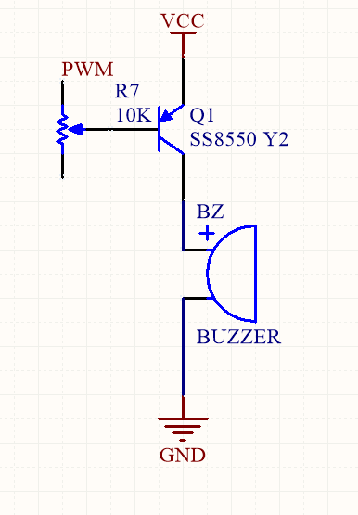
UESTC 信息与通信工程学院(School of Information and Communication Engineering) 学生创新创业中心(Center for Student Innovation and Entrepreneurship)
In different digital systems, the definition of logic 0 and logic 1 are different.
3.3V
0(Low level) means logic 0
1(High level) means logic 1
Positive logic
1(High level) means logic 0
0(Low level) means logic 1
Negative logic
0V
Then, what is the high threshold? What about the low threshold?

Slide 7
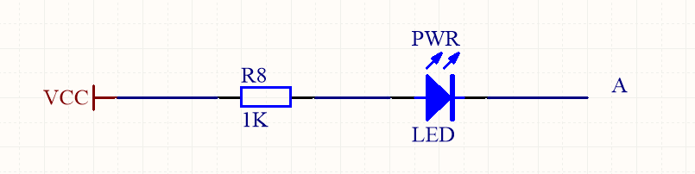
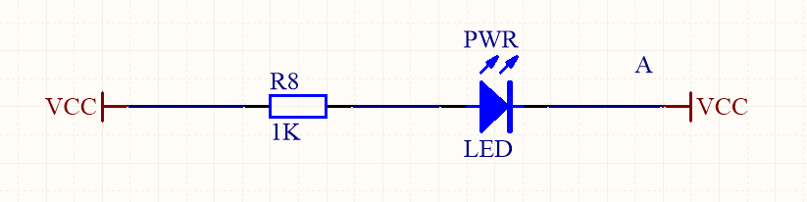
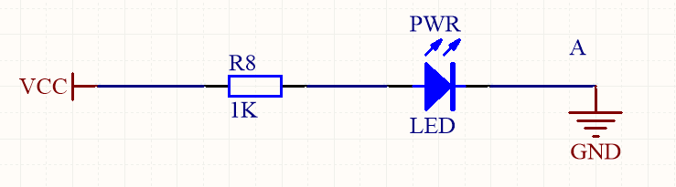
UESTC 信息与通信工程学院(School of Information and Communication Engineering) 学生创新创业中心(Center for Student Innovation and Entrepreneurship)
A simple use of digital signals: Light up a LED
When A is at the high level(VCC), the LED light goes out.
When A is at the low level(GND), the LED is lit up.

Slide 8
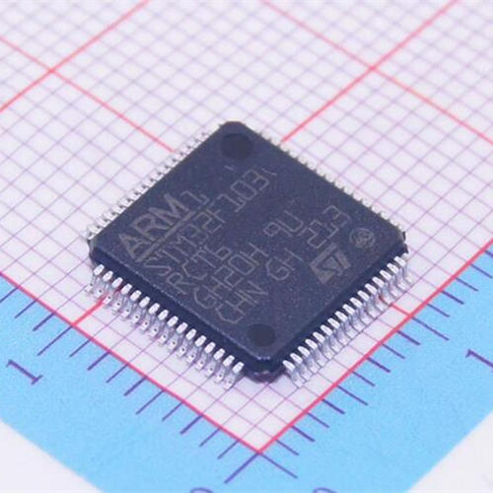
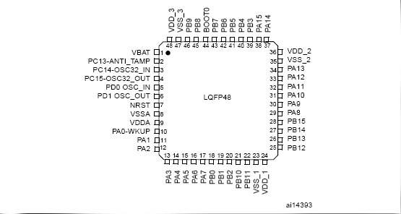
UESTC 信息与通信工程学院(School of Information and Communication Engineering) 学生创新创业中心(Center for Student Innovation and Entrepreneurship)
MCU
(Microcontroller Unit)
STM32F103RCT6

Slide 9
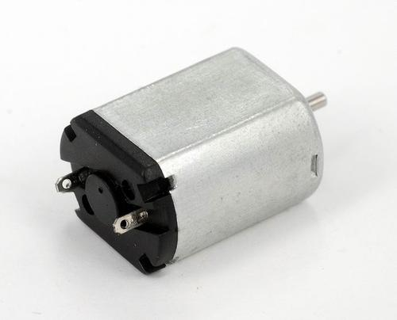
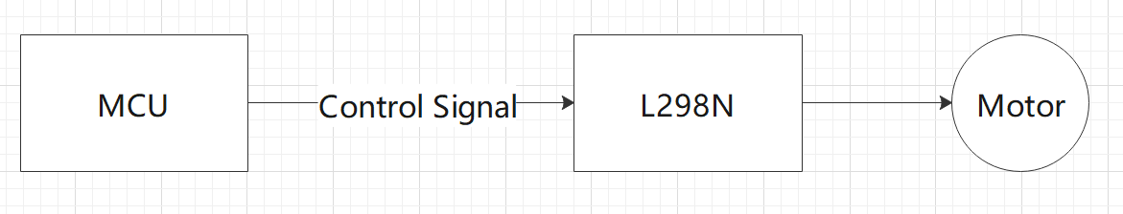
UESTC 信息与通信工程学院(School of Information and Communication Engineering) 学生创新创业中心(Center for Student Innovation and Entrepreneurship)
1.2 L298N Motor drive module & Mecanum wheel
What method do we have to drive the motor?

Slide 10
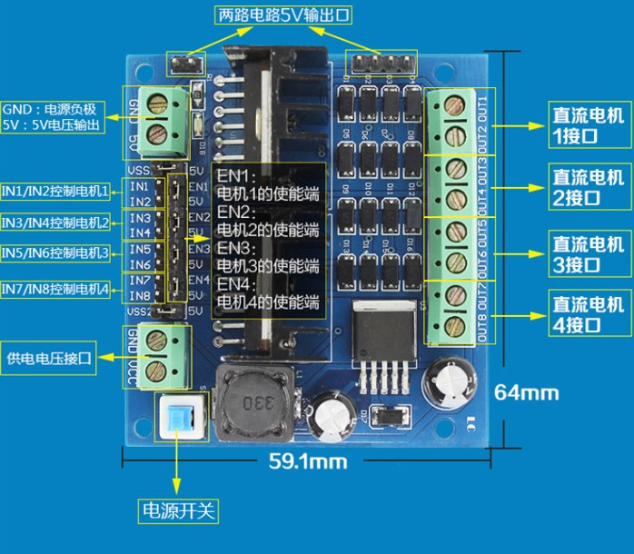
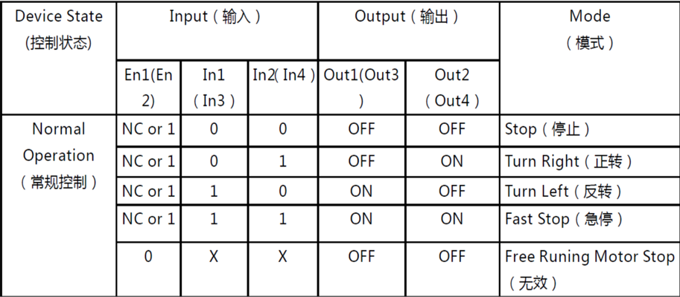
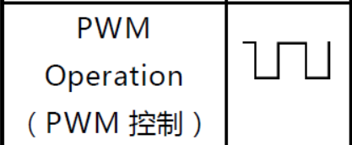
UESTC 信息与通信工程学院(School of Information and Communication Engineering) 学生创新创业中心(Center for Student Innovation and Entrepreneurship)

Slide 11
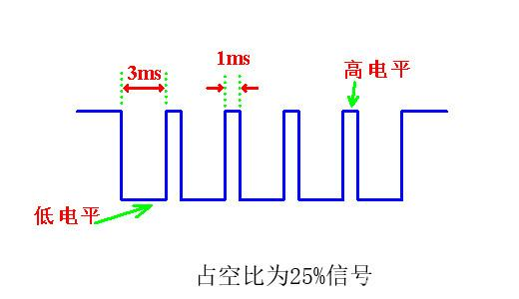
UESTC 信息与通信工程学院(School of Information and Communication Engineering) 学生创新创业中心(Center for Student Innovation and Entrepreneurship)
What is PWM？
PWM-Pulse width modulation
Duty cycle-In each working cycle, the high level time as a percentage of the working cycle.

Slide 12
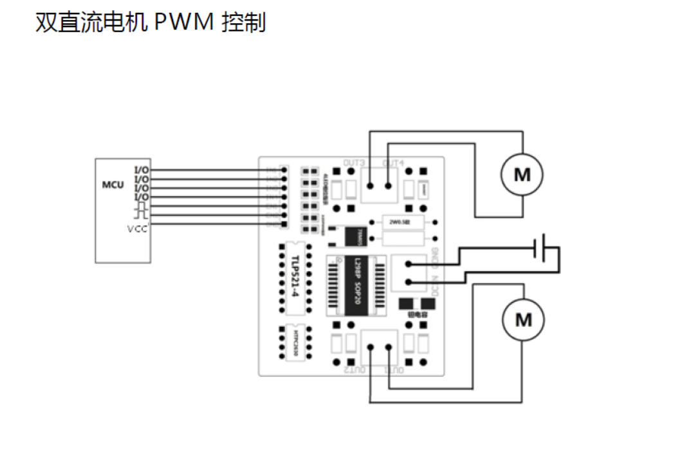
UESTC 信息与通信工程学院(School of Information and Communication Engineering) 学生创新创业中心(Center for Student Innovation and Entrepreneurship)

Slide 13
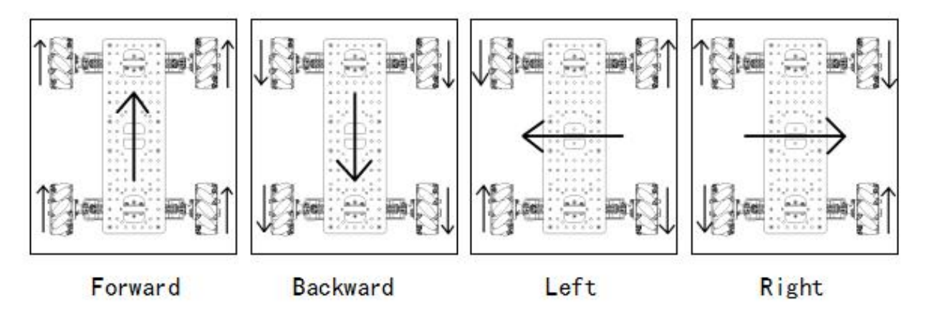
UESTC 信息与通信工程学院(School of Information and Communication Engineering) 学生创新创业中心(Center for Student Innovation and Entrepreneurship)
Mecanum wheel

Slide 14
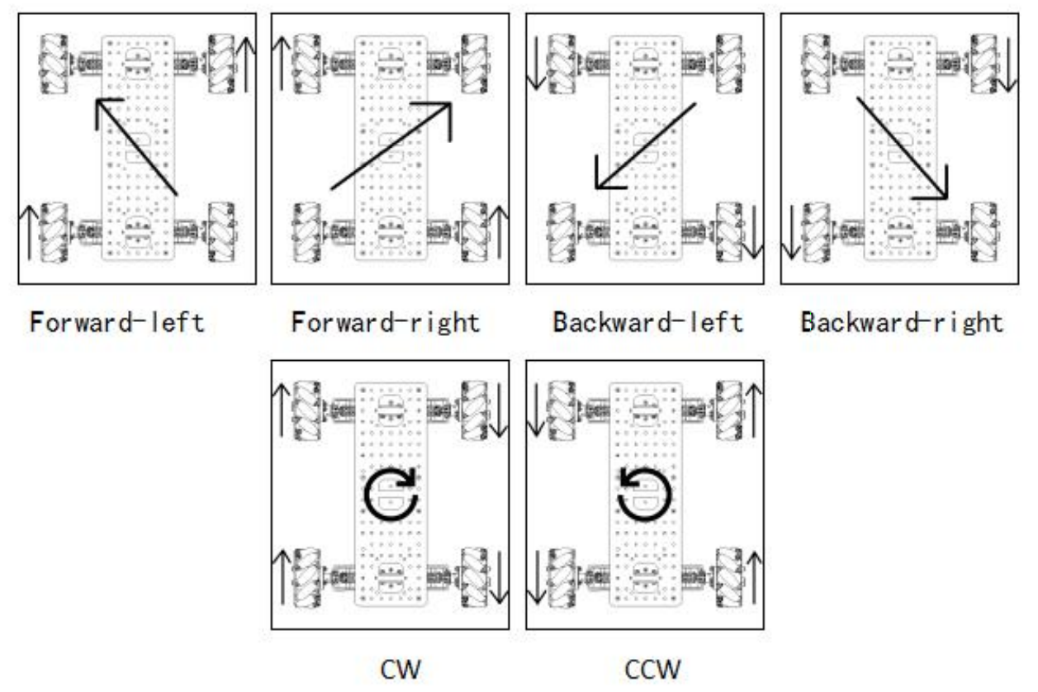
UESTC 信息与通信工程学院(School of Information and Communication Engineering) 学生创新创业中心(Center for Student Innovation and Entrepreneurship)

Slide 15
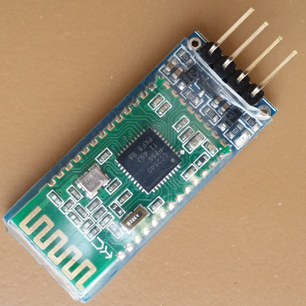
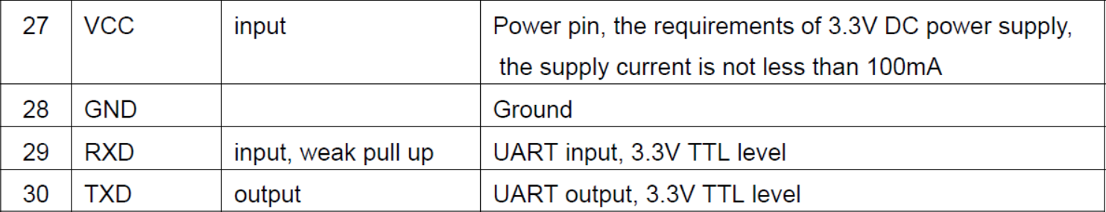
UESTC 信息与通信工程学院(School of Information and Communication Engineering) 学生创新创业中心(Center for Student Innovation and Entrepreneurship)
1.3 HC-08D(Bluetooth communication module

Slide 16
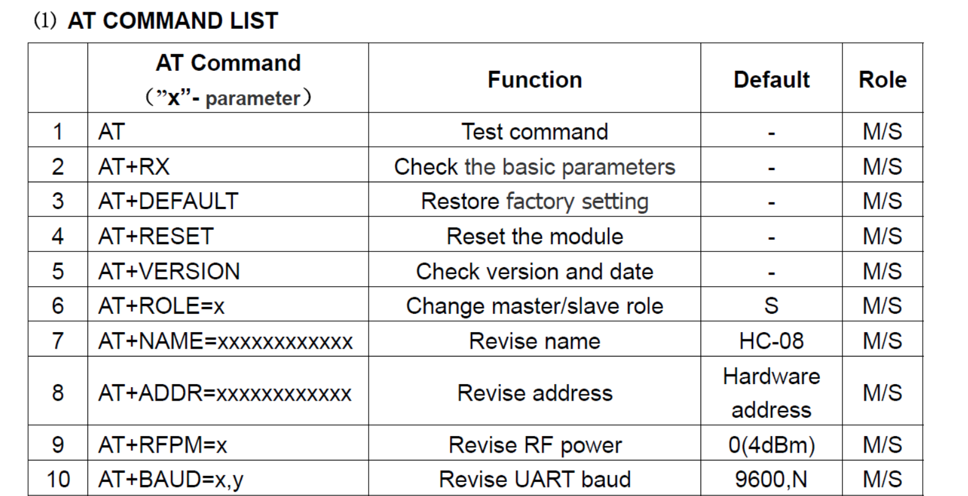
UESTC 信息与通信工程学院(School of Information and Communication Engineering) 学生创新创业中心(Center for Student Innovation and Entrepreneurship)

Slide 17
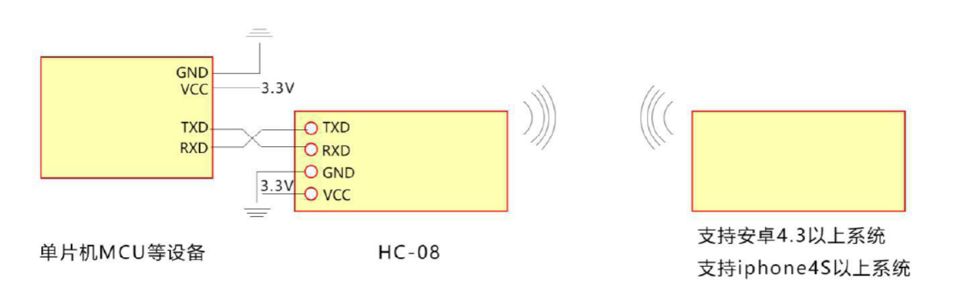
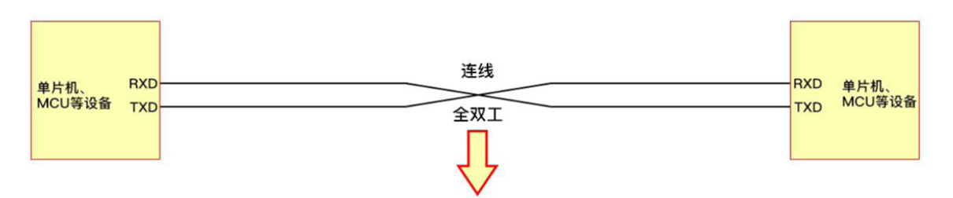
UESTC 信息与通信工程学院(School of Information and Communication Engineering) 学生创新创业中心(Center for Student Innovation and Entrepreneurship)
The connection between MCU and HC-08D

Slide 18
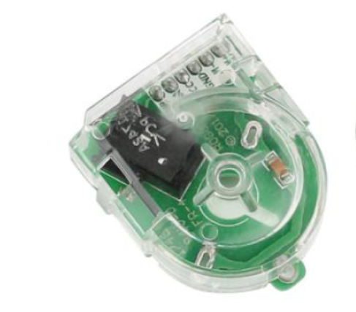
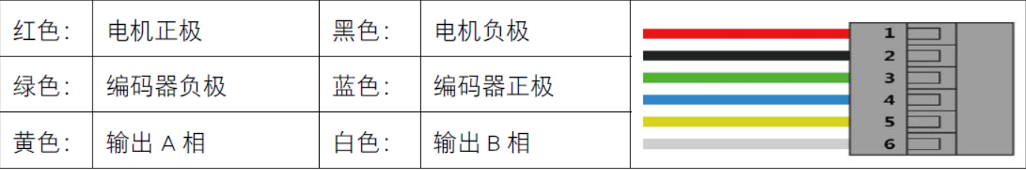
UESTC 信息与通信工程学院(School of Information and Communication Engineering) 学生创新创业中心(Center for Student Innovation and Entrepreneurship)
1.4 Encoder

Slide 19
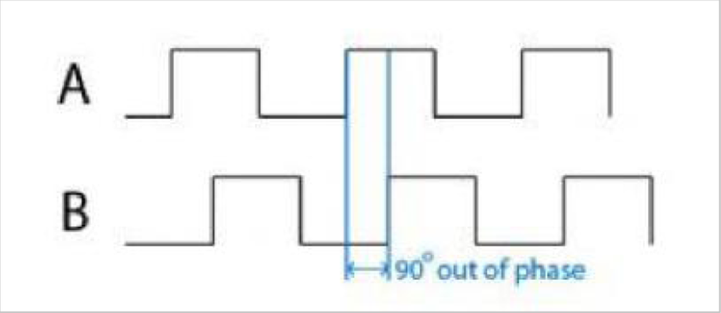
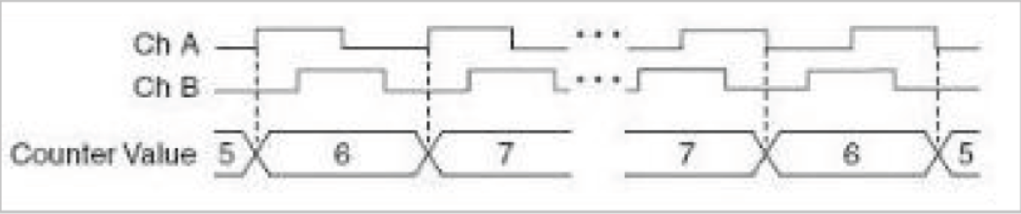
UESTC 信息与通信工程学院(School of Information and Communication Engineering) 学生创新创业中心(Center for Student Innovation and Entrepreneurship)

Slide 20
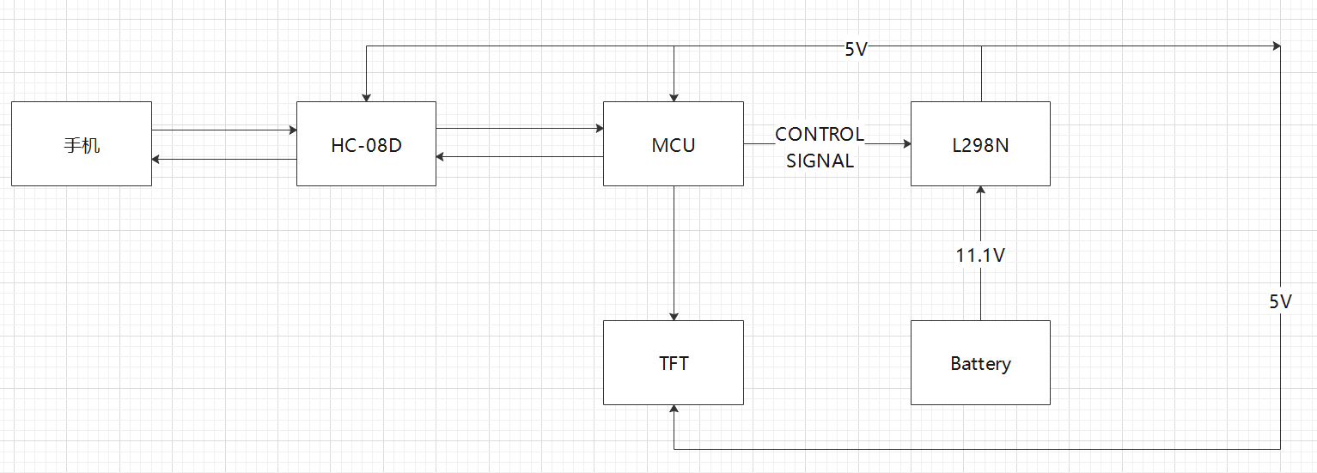
UESTC 信息与通信工程学院(School of Information and Communication Engineering) 学生创新创业中心(Center for Student Innovation and Entrepreneurship)
The whole structure of hardware
Mobile phone

Slide 21
UESTC 信息与通信工程学院(School of Information and Communication Engineering) 学生创新创业中心(Center for Student Innovation and Entrepreneurship)
03
PART
Software-programming

Slide 22
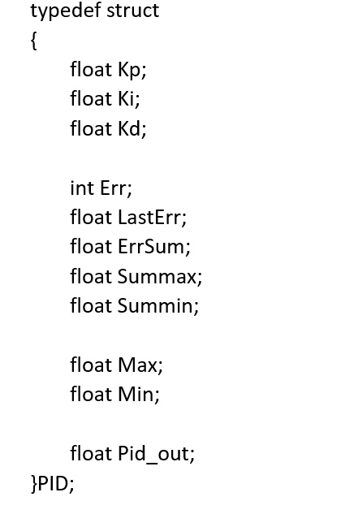
UESTC 信息与通信工程学院(School of Information and Communication Engineering) 学生创新创业中心(Center for Student Innovation and Entrepreneurship)
2.1 L298N Motor drive module
Open loop control: Have no feedback, the input do not affect by the output.
Closed-loop control: Have a feedback, we can use the feedback to modulate the input to have less deviation.
Using open loop may cause many problems. So we will not use open loop!
We use the PID closed loop operation (a kind of closed loop algorithm).

Slide 23
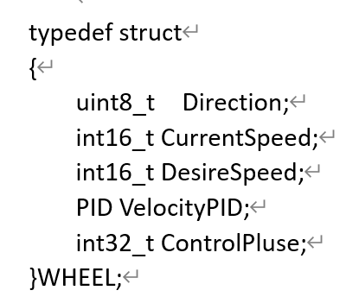
UESTC 信息与通信工程学院(School of Information and Communication Engineering) 学生创新创业中心(Center for Student Innovation and Entrepreneurship)
Wheel Part:
Define the corresponding structure WHEEL for the wheel, following is a description of the member variables:
- uint8_t Direction Current wheel direction，using the data from function CarUpdate(ToyCar * car) to update.
-int16_t CurrentSpeed Current wheel speed, positive rotation (going forward) is positive, reverse rotation (going backward) is negative, the value is assigned by the encoder, the maximum value is 2199.
- int16_t DesireSpeed The desired speed we set.
- PID VelocityPID The PID control structure for this wheel.
- int32_t ControlPluse The value which control the duty cycle of the wheel PWM, the maximum value is 9999.

Slide 24
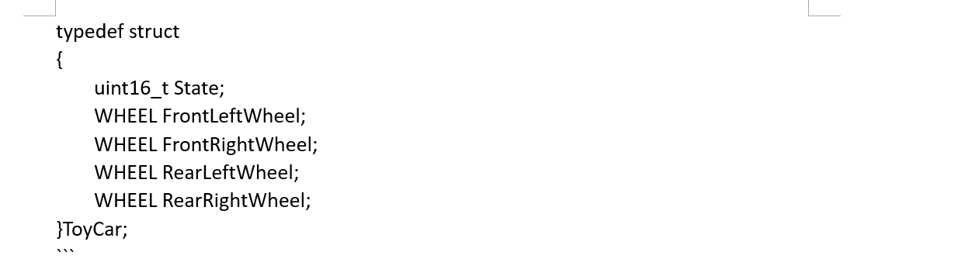
UESTC 信息与通信工程学院(School of Information and Communication Engineering) 学生创新创业中心(Center for Student Innovation and Entrepreneurship)
For the entire trolley system:
Define the corresponding structure ToyCar for the entire trolley, following is a description of the member variables:
-uint16_t State The current state of the trolley, the possible value could be Wheel_Reverse/ Wheel_Forward /Wheel_Stop
- WHEEL xxxxxWheel each exact wheel

Slide 25
UESTC 信息与通信工程学院(School of Information and Communication Engineering) 学生创新创业中心(Center for Student Innovation and Entrepreneurship)
Control.c/h:
Mainly about the program of car control, following are the main functions:
VelocityPidCallFnx (ToyCar*Car): The function used to set the speed of each wheel, change the speed of the wheel by changing the value of variable Car->XXXWheel.DesireSpeed through the command change from Bluetooth and serial port. and to change the speed through this variable is done by the function of the PWM control.
CarInit(ToyCar * Car): The function used to initialize the state of volley, which contains the initial values of various parameters.
CarUpdate(ToyCar * car):The function used to update status, after we complete some corresponding operation we also call this function to control the car.
L298N.c/h:
This file is mainly a driver function for the motor module, following are the main functions:
L298N_GPIO_INIT (void): The function configure the connection between the motor and the MCU. It is through this document that we determine how to connect our external circuits.
L298N_SetDirection (uint8_t wheel, uint8_t dir): The function set the input direction of the motor module current and whether or not it is output to control the direction of the wheels.

Slide 26
UESTC 信息与通信工程学院(School of Information and Communication Engineering) 学生创新创业中心(Center for Student Innovation and Entrepreneurship)
pid.c/h:
This file contains more about basic programs, which focusing more on direct control of circuits and devices, and it is the basis for the rapid implementation of the above two files.
PID_Init(PID *PID,float kp,float ki,float kd,float max,float min,float Summax,float Summin)：The structure of PID, put every variable in one structure for convenient use.
PID_Cal(PID *PID,float goal,float now_val)：This function use the data in function 1(PID_Init(PID *PID,float kp,float ki,float kd,float max,float min,float Summax,float Summin)) to calculate the corrected value.
Motor_SetPWM(uint8_t wheel, int pluse): The direct control of PWM output, also the root function of subsequent speed control in the Control.c file.

Slide 27
UESTC 信息与通信工程学院(School of Information and Communication Engineering) 学生创新创业中心(Center for Student Innovation and Entrepreneurship)
2.2 HC-08
USART2/3.c/h:
These two files are mainly serial communication-related files, we do not need to deeply studied, the main role of them is to configure serial port to build up the communication between serial ports, we will not use the functions of these two files.

Slide 28
UESTC 信息与通信工程学院(School of Information and Communication Engineering) 学生创新创业中心(Center for Student Innovation and Entrepreneurship)
The whole structure of software
In the main function, individual clocks and channels are configured to facilitate the PWM output to control the speed and direction of the motor.
The main function eventually executes a while(1) loop statement, after which no programs other than interrupts can be executed, and only interrupts can control and change the states of the car.
We can send serial data to the MCU via Bluetooth, and after the MCU receives the serial data, the program will enter the serial interrupt and process the serial data.
In the serial interrupt program, after the data is processed, and finally call the functions in the Control.c file to control the car, which in turn realizes the function of using the mobile phone to control the car.

Slide 29
UESTC 信息与通信工程学院(School of Information and Communication Engineering) 学生创新创业中心(Center for Student Innovation and Entrepreneurship)
04
PART
Question

Slide 30
UESTC 信息与通信工程学院(School of Information and Communication Engineering) 学生创新创业中心(Center for Student Innovation and Entrepreneurship)
THANKS

